Slide 2
Sharing to be better
P&A of old subsea well

Slide 3
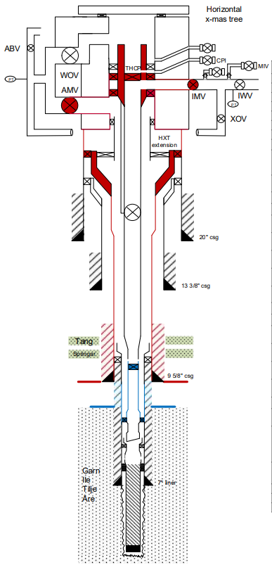
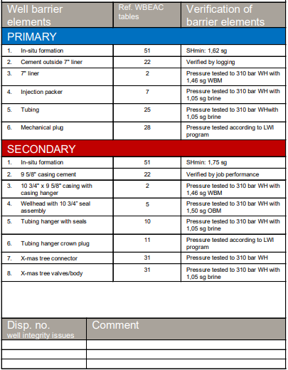
Planned operations
P&A and perform sidetrack on 21 years old subsea injector.
Well have been re-drilled and recompleted several times. This is 4th track.
13 3/8’’ and 9 5/8’’ casing installed in 2014 in oil based mud. Last operation on well, a recompletion in 2017.
Pre-P&A performed by RLWI (Riserless Light Well Intervention). Installed deep mechanical plug, cut tubing and displaced A-annulus to new fluid from cut and up.
Planned as standard P&A including pulling tubing, 9 5/8’’ casing and 13 3/8’’ casing. Next sidetrack to start from 20’’ casing using whipstock.
Which risks do you recognise for this type of P&A operation?
What are the main differences plugging subsea wells compared to platform wells?
How would you prepare for this operation?
Barrier status after RLWI operation:

Slide 4
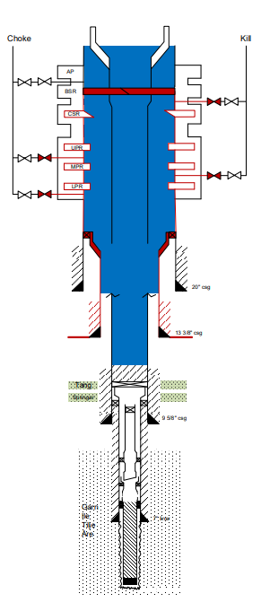
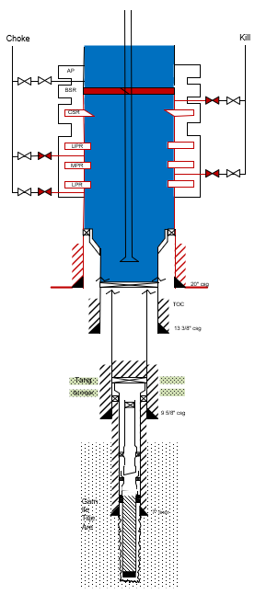
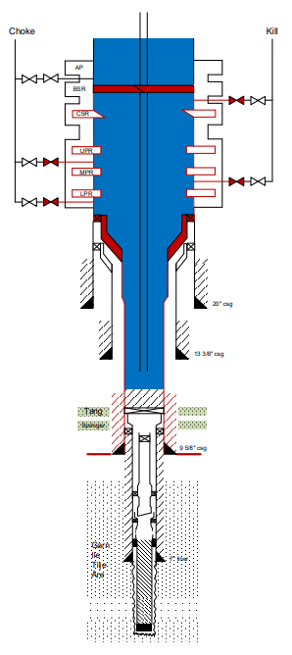
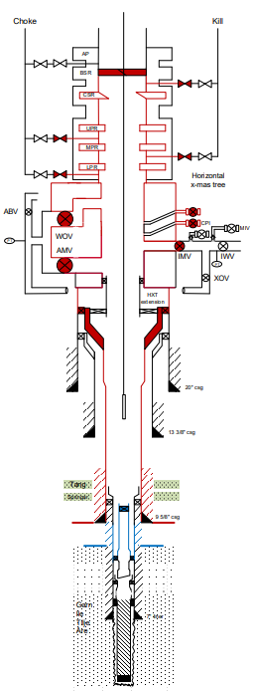
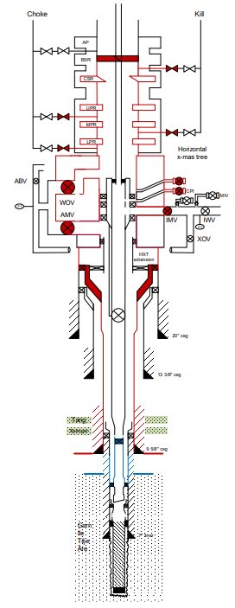

P&A operations
Pull tubing
Log 9 5/8’’ casing
Set permanent cement barriers towards reservoir and flow units in overburden in 9 5/8’’ casing
Cut & Pull 9 5/8’’ x 10 ¾’’ casing
All went according to plan
Next operations:
    Cut 13 3/8’’ casing, Pull seal assembly and retrieve 13 3/8’’ casing.
    Perform clean-out in 20’’ casing prior to install plug and whipstock.
Set plug in 13 3/8’’ casing
All went according to plan​
Next operations:​
Cut 13 3/8’’ casing, Pull seal assembly and retrieve 13 3/8’’ casing.
    Perform clean-out in 20’’ casing prior to install plug and whipstock. ​

Slide 5
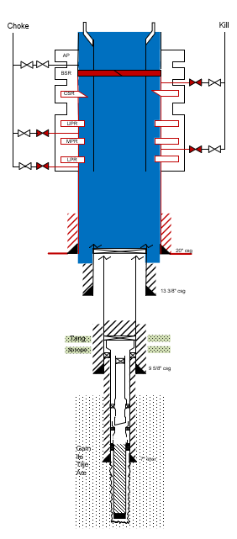
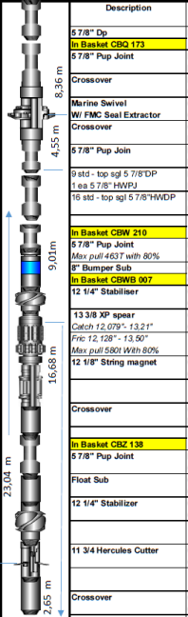
Pull 13 3/8’’ casing
Combination run planned for operation:
  Cut 13 3/8’’ casing at 1086 m
  Pull seal assy with closed BOP – cross circulate. Continue operation based on gas response:
    No gas: Retrieve 13 3/8’’ casing with combination run - spear without packoff
    Gas during cross circulation: POOH and M/U spear with pack-off
Which risks do you see from this operation?
Which risks are added when using a combination run without pack-off?
Operations went according to plan. No/little gas seen during cross circulation – pulled casing using combination BHA without possibility to circulate the ‘’long way’’
  pulled 13 3/8’’ casing. – stable well
What do we now know about the fluid left in hole?

Slide 6
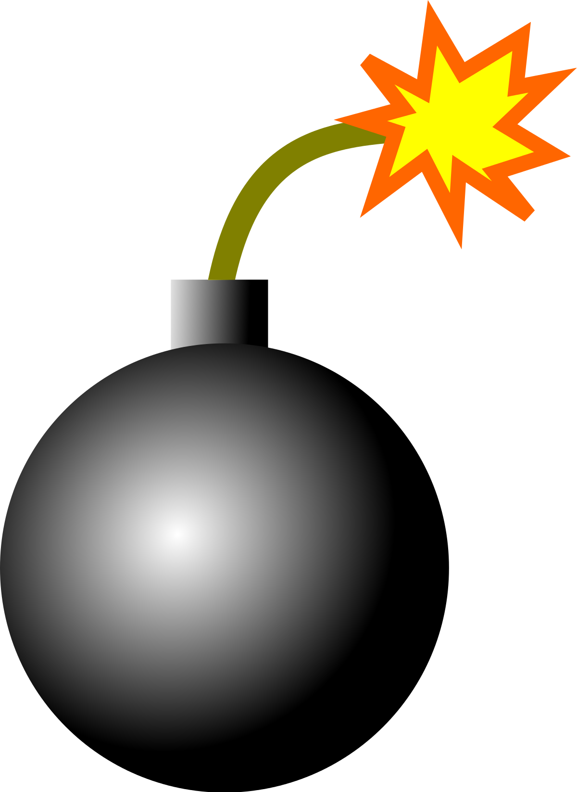
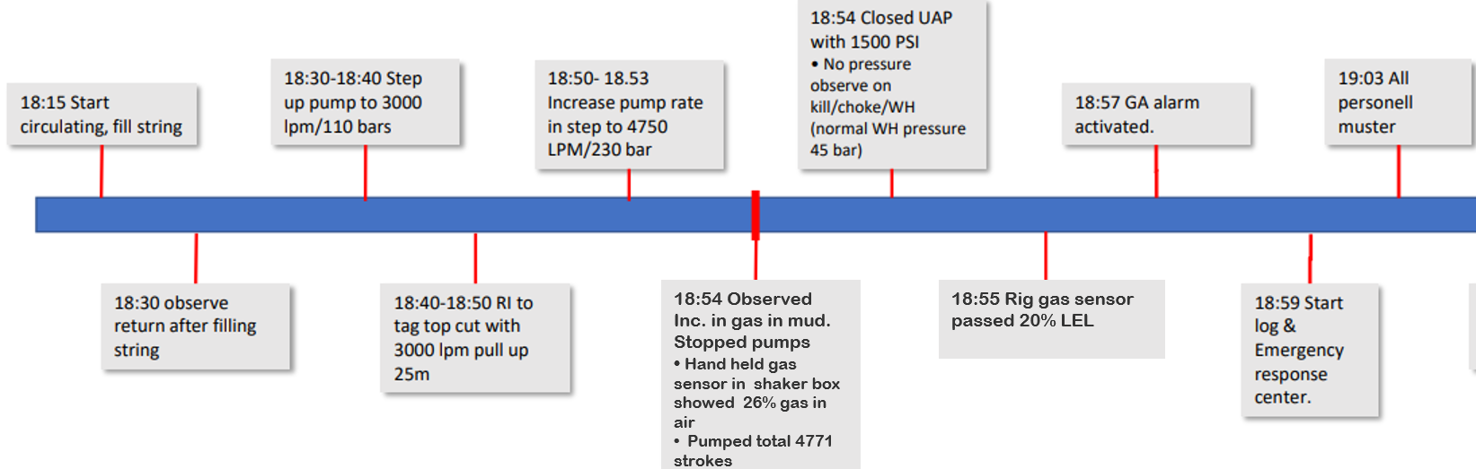
The incident
Plan:
  M/U and RIH with 20’’ clean-out BHA
  Drift casing to whipstock depth
  Clean whipstock setting area while circulating
Risk identified prior to operation:
  CO/H2S from old mud behind casing left in hole.
  Less focus on potential HC behind casing
Situation Awareness - what have happened?
6 |

Slide 7
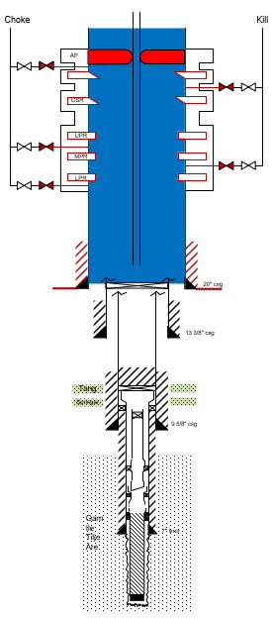
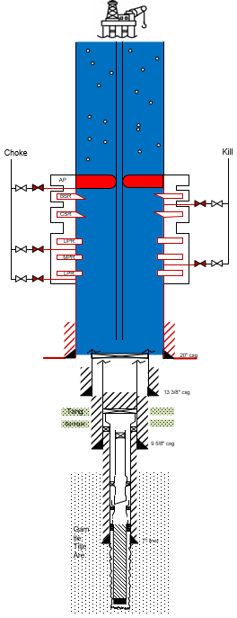
The incident continue
BOP closed. Circulated 3 BU to circulate gas out to 6%. Open BOP. Well stable – no pressure, no flow
Attempted to circulate up riser 600 lpm – new gas alarm. Gain in active.
Closed BOP - Well Stable – No pressure, no flow
Attempted to boost riser with 200 lpm – new gas alarm in shaker room
Stopped and evaluated situation
Situation awareness - what have happened?
How would you handle the gas cut mud in riser on your rig?
WBS as presented
WBS modified with gas cut mud in riser
7 |

Slide 8
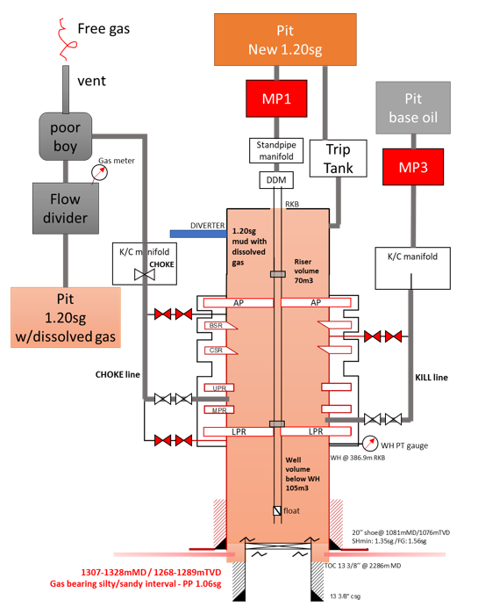
One solution to handle the gas cut mud in riser.
Decided to u-tube riser by displacing down kill and up choke with base-oil with closed AP and LPR, and then open AP to get riser volume to drop and u-tube into choke line, while filling riser with fresh 1.20sg OBM.
LPR isolated the well below and pressure was monitored at all times on WH gauge to maintain constant hydrostatic column.
33 steps were needed to u-tube all riser volume. Final gas reading on riser fluid was 2,85%.
8 |

Slide 9

Learnings and recommendations
Subsea wells offer limited information from casing annuluses compared to platform wells.
Oil based mud can have significant amount of gas dissolved that can release in riser
Flow checks and cross circulation at BOP will not fully de-risk gas dissolved in oil-based mud left behind old casing
Combination runs may limit the possibilities to identify / handle gas cut mud left behind casings
Gas in riser are challenging and time consuming to handle
Any learnings relevant for your operations?
9 |

